Slide 1

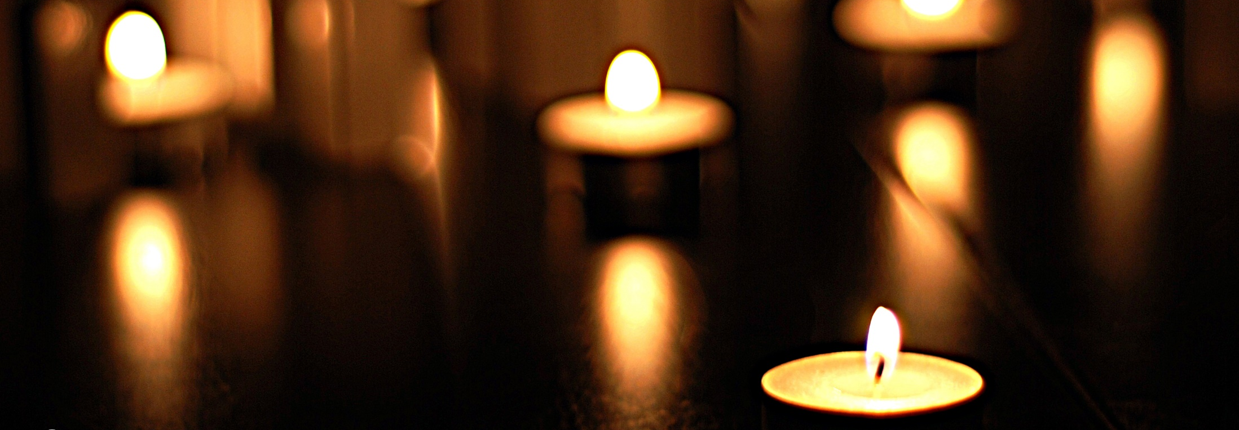

Insert your organisation’s logo here
Holocaust Memorial Day
[Insert organisation name]
Notes:
Welcome to [organisation]’s Holocaust Memorial Day event. We are pleased that you are able to join us to learn about Holocaust Memorial Day, remember those who were murdered and reflect on how we can take action to create a better future together.
This ceremony will last for approximately 45 minutes and will feature the experiences of people who survived the Holocaust and genocide. We hope you will find the event moving, informative and engaging, and that it will inspire you to take action for a safer future.
In terms of housekeeping, this event is taking place live, so the films cannot be paused. All attendees have been placed on mute, but we would appreciate it if you could put your phones on silent and give this event your full attention. Towards the end of the ceremony, there will be an opportunity for everyone to light a candle and take part in a minute’s silence, so please have a candle and lighter ready if you would like to participate.
We will now move onto an introduction to today’s ceremony from [name].

Slide 2
Introduction from organisation
Notes:
Friends, thank you for joining us to mark Holocaust Memorial Day at [organisation]. Your attendance is part of the national picture of Holocaust Memorial Day, with thousands of activities taking place across the UK – supported by the Holocaust Memorial Day Trust. We know that everyone who attends Holocaust Memorial Day events learns more, empathises more deeply, and goes on to take action to build a better future.
Holocaust Memorial Day is the international day on 27 January to remember the six million Jews murdered during the Holocaust, alongside the millions of other people killed under Nazi persecution of other groups and in more recent genocides in Cambodia, Rwanda, Bosnia and Darfur.
The Holocaust threatened the fabric of civilisation, and genocide must still be resisted every day. Our world often feels fragile and vulnerable and we cannot be complacent. Even in the UK, prejudice and the language of hatred must be challenged by us all.
We meet today at a time when we see division at home and abroad, with many of us experiencing uncertainty and worry for our families and communities. Increasing levels of denial, division and misinformation in today’s world mean we must remain vigilant against hatred and identity-based hostility. Yet we know tens of thousands of people are coming together to mark HMD, to help those in need and to build a better future. Communities are standing in solidarity and experiencing togetherness, even while we are apart.
The theme for Holocaust Memorial Day (HMD) 2023 is Ordinary People. It encourages everyone to reflect on the depths humanity can sink to, but also the ways individuals and communities resisted that darkness to ‘be the light’ before, during and after genocide.
Be the light in the darkness is an affirmation and a call to action for everyone marking HMD. We can all stand in solidarity. We can all choose to be the light in the darkness.

Slide 3
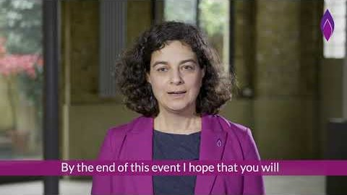
Introduction
Notes:
The Holocaust Memorial Day Trust is the charity that promotes and supports Holocaust Memorial Day across the UK. The charity’s Chief Executive, Olivia Marks-Woldman, has provided a message to all attendees of today’s event.

Slide 4
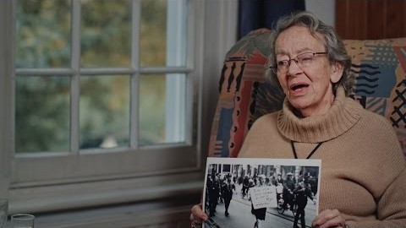
Bea Green’s testimony
Notes:
Bea Green was born in Munich in 1924. When she was a teenager she fled rising violence and persecution of Jews in Germany by coming to the UK on the Kindertransport. This is her story.

Slide 5
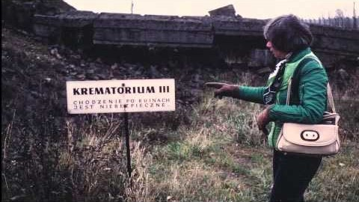
Learning from the Past
Notes:
Bea Green’s story is a very powerful one, but the experiences she describes are far from unique. In this next film from the Holocaust Memorial Day Trust, which is narrated by Imelda Staunton, we learn about the atrocities that we commemorate on Holocaust Memorial Day, and the importance of learning from the past.

Slide 6
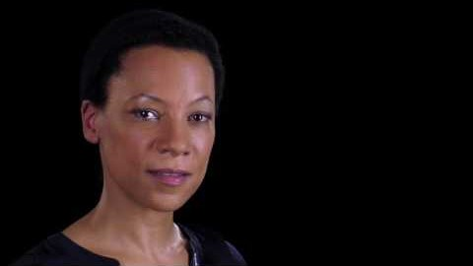
Colors by Michaella Rugwizangoga
Notes:
As we learned in the previous film, although world leaders said ‘Never Again’, after the Holocaust, genocide has taken place many times in the years since.
In 1994, Rwanda was devastated by a genocidal conflict which saw members of the Hutu tribe massacre Tutsi men, women and children, as well as moderate Hutus. The Government and Armed Forces encouraged civilians to carry out the murder of their neighbours and friends. In just 100 days approximately one million Tutsis and moderate Hutus were murdered.
In this next film, actress Nina Sosanya reads the poem Colors - A thought to all the survivors of the 1994 genocide by Michaella Rugwizangoga, an award-winning Rwandan poet. The poem was dedicated to the survivors of the genocide as a message of hope and solidarity.
Transcript:
Red, Blue, Yellow Green, White, Purple Jasmine, Orange, Azure
Old pallor's, Make way for new homes A future spread with colours A horizon without sorrow Here ends our pain. Here begins life

Slide 7
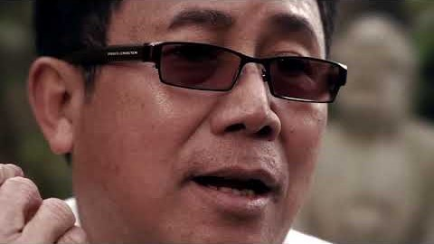
Sokphal Din’s testimony
Notes:
Script:
The atrocities that took place in Cambodia shocked the world after the radical communist political party Khmer Rouge, under their leader Pol Pot, seized power in April 1975 after years of guerrilla warfare. In this film made by the Holocaust Memorial Day Trust, Sokphal Din tells his story of surviving forced labour in Cambodia’s notorious killing fields.
Transcript:
[Sokphal is sitting in his garden, talking direct to camera]
1975, just after new year, April, my family was having breakfast in the morning. Somebody knocked the door, the front door. It was the Pol Pot soldier, with the black uniform and the gun. And point the gun at us, saying, ‘You got to get out of your house right now or we shoot you.’
So myself, I was about 14 or 13, 14, they forced me to work hard labour in the field, the corn field. They told us, if anyone soldier or teacher, anyone well educated, tell them that you are what you are and then they send you back to Phnom Penh. They send you to study. After three month you come back, or you join your family. So my father talking with my mum, thinking, what shall we do?
I remember the night before he left the family to join training; my father gave me his necklace. He gave it to me and said, ‘Please look after this, and look after your brother and sister. Look after your mum, and I don’t know when I come back. Now you, it’s your duty now to look after the family.’ And at the time I didn’t have any emotion, we just feel, OK, you go now, and three month you come back and take me with you, kind of thing, and I will see you again.
We waited and waited. There’s no news back at all. Then one day, they told us, ‘Oh, you’re going to join your family now.’ I was so excited, my mum excited, and suddenly somebody, the farmer, told us, say, ‘It’s not true. They not taking you back to Phnom Penh. They take you to fill the jungle.’ And we knew that we’d never go back. We knew this is a lie. They just want to kill us. And we knew that we’d never see our father again. We kept hoping, but we knew that it’s impossible.
They took us through the jungle, until we got to the place. Completely jungle. Completely… nothing there at all. They just left you there. To die, basically.
So my grandmother really hungry, so I fed her this egg to eat, boiled egg, and she couldn’t swallow it, she couldn’t swallow, she couldn’t chew, because she is too ill to eat anything. And I hold her head in my arms like that. So that night we slept in the same mosquito net. Nearly morning, when I touch her, she felt, she – I felt cold. So we all wake up, woke up, and look at her, she already pass away. I felt so sad to see her burn, burning, cremated, underneath the pile of wood in the jungle.
After my grandmother died, they separate me, took my away to work in hard labour. I came to see them, but I can’t stay there more than one day, I had to go back next day. And I found out my brother really ill who was, must have been six years old. His name is Gosawa.
And I remember that morning, that day when I left, I heard my brother, not shouting, but crying. He swore to the Communist Khmer Rouge, said, ‘You took my brother away. I never see him again. You took my brother away. You are terrible. You burn to hell. I condemn you. Please stay brother, I want you to stay with me, don’t go, please don’t go.’ He begging me, and I can hear, I could hear his voice now, cry and begging me not to go back. I walked out in tears. I could not stop. And then two days later, I got the news from my mother, said my brother died.
Some people got the radio, we heard about Vietnamese invaded Cambodia. So they forced me to join the army. And I thought to myself, I’ll never ever kill anybody. I can’t refuse it, but I had to take the order. One day, we heard the sound of the tanks, the ground shaking everything. And we knew the Khmer Rouge soldiers disappeared.
Vietnamese was in the village already. That day, they put me in the brick oven. So we had to sit against the wall in circle in the oven. And I thought to myself that day, I thought, ‘that’s it. That’s it. They’re gonna burn us alive in here.’ I didn’t say nothing. I thought, ‘I’m gonna die’. They moved me to Siem Reap prison. After many months in the prison I was released.
So we spent time in the refugee camp until I found my cousin in England. She sponsored me, and through the Red Cross, I came to England in August 1987.
All the memories in the killing field still with me every day. I had nightmares all the time, even the night before, yesterday, I had nightmare. I dreamt that I was there and I tried to escape from the water, and at some point – I seen so many things, I seen dead bodies next to me, I seen a lot of things, so I can’t describe it, but it still upset me, it’s really a nightmare.

Slide 8
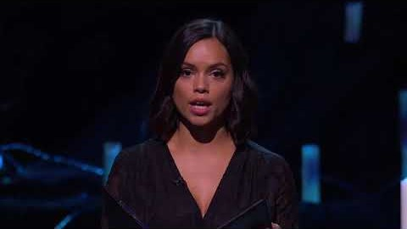
The Persecution of Rohingya Muslims: Hansu Mala’s story
Notes:
Script:
Despite the horrors of the Holocaust and Nazi persecution of other groups, and the more recent genocides in Cambodia, Rwanda, Bosnia and Darfur, people continue to be subject to persecution and violence based on their identities, in the UK and around the world.
In December 2019, the United Nations passed a resolution strongly condemning rights abuses against Rohingya Muslims and other minority groups in Myanmar, including arbitrary arrests, torture, rape and deaths in detention. Myanmar has been accused of genocide against the Rohingya and more than 700,000 Rohingya refugees have fled to Bangladesh since August 2017 to escape the violence.
In this film from the UK Ceremony for Holocaust Memorial Day 2020, actress Georgina Campbell reads the testimony of Hansu Mala, a Rohingya Muslim from the Rakhine State of Myanmar. This is her story.

Slide 9
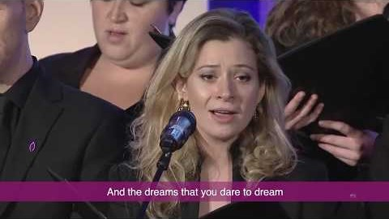
Somewhere Over the Rainbow Performed by the Fourth Choir
Notes:
Script:
The Holocaust and the genocides that followed shook the foundations of society. These tragedies demonstrate the deadly consequences of allowing hatred and prejudice to go unchecked. But genocide doesn’t happen overnight: it is a process which can be stopped at any stage through acts of kindness, resistance and stories of hope.
For the 2019 UK Holocaust Memorial Day ceremony, the Fourth Choir, London’s LGBT+ chamber choir, performed Somewhere Over the Rainbow. One of the world’s best known songs, it was written in 1938 by Harold Arlen and Yip Harburg, two Jewish Americans, and it embodies a longing for a better world during troubled times.

Slide 10
Statement of Commitment for HMD
1. We recognise that the Holocaust shook the foundations of modern civilisation. Its unprecedented character and horror will always hold universal meaning
Notes:
Script:
Holocaust Memorial Day was created on 27 January 2000, when representatives from 46 governments around the world met in Stockholm to discuss Holocaust education, remembrance and research. At the end of this meeting, all attendees signed a declaration committing to preserving the memory of those who were murdered in the Holocaust and in the subsequent genocides.
We will now read the Statement of Commitment which was adapted from this declaration, to affirm our support for Holocaust remembrance and ensure that these horrors are never forgotten.

Slide 11
Statement of Commitment for HMD
2. We believe the Holocaust must have a permanent place in our nation’s collective memory. We honour the survivors still with us, and reaffirm our shared goals of mutual understanding and justice
Notes:
Script:

Slide 12
Statement of Commitment for HMD
3. We must make sure that future generations understand the causes of the Holocaust and reflect upon its consequences. We vow to remember the victims of Nazi persecution and of all genocides
Notes:
Script:

Slide 13
Statement of Commitment for HMD
4. We value the sacrifices of those who have risked their lives to protect or rescue victims, as a touchstone of the human capacity for good in the face of evil
Notes:
Script:

Slide 14
Statement of Commitment for HMD
5. We recognise that humanity is still scarred by the belief that race, religion, disability or sexuality make some people’s lives worth less than others’. Genocide, anti-semitism, racism, xenophobia and discrimination still continue. We have a shared responsibility to fight these evils
Notes:
Script:

Slide 15
Statement of Commitment for HMD
6. We pledge to strengthen our efforts to promote education and research about the Holocaust and other genocides. We will do our utmost to make sure that the lessons of such events are fully learnt
Notes:
Script:

Slide 16
Statement of Commitment for HMD
7. We will continue to encourage Holocaust remembrance by holding an annual Holocaust Memorial Day. We condemn the evils of prejudice, discrimination and racism. We value a free, respectful, and democratic society
Notes:
Script:

Slide 17
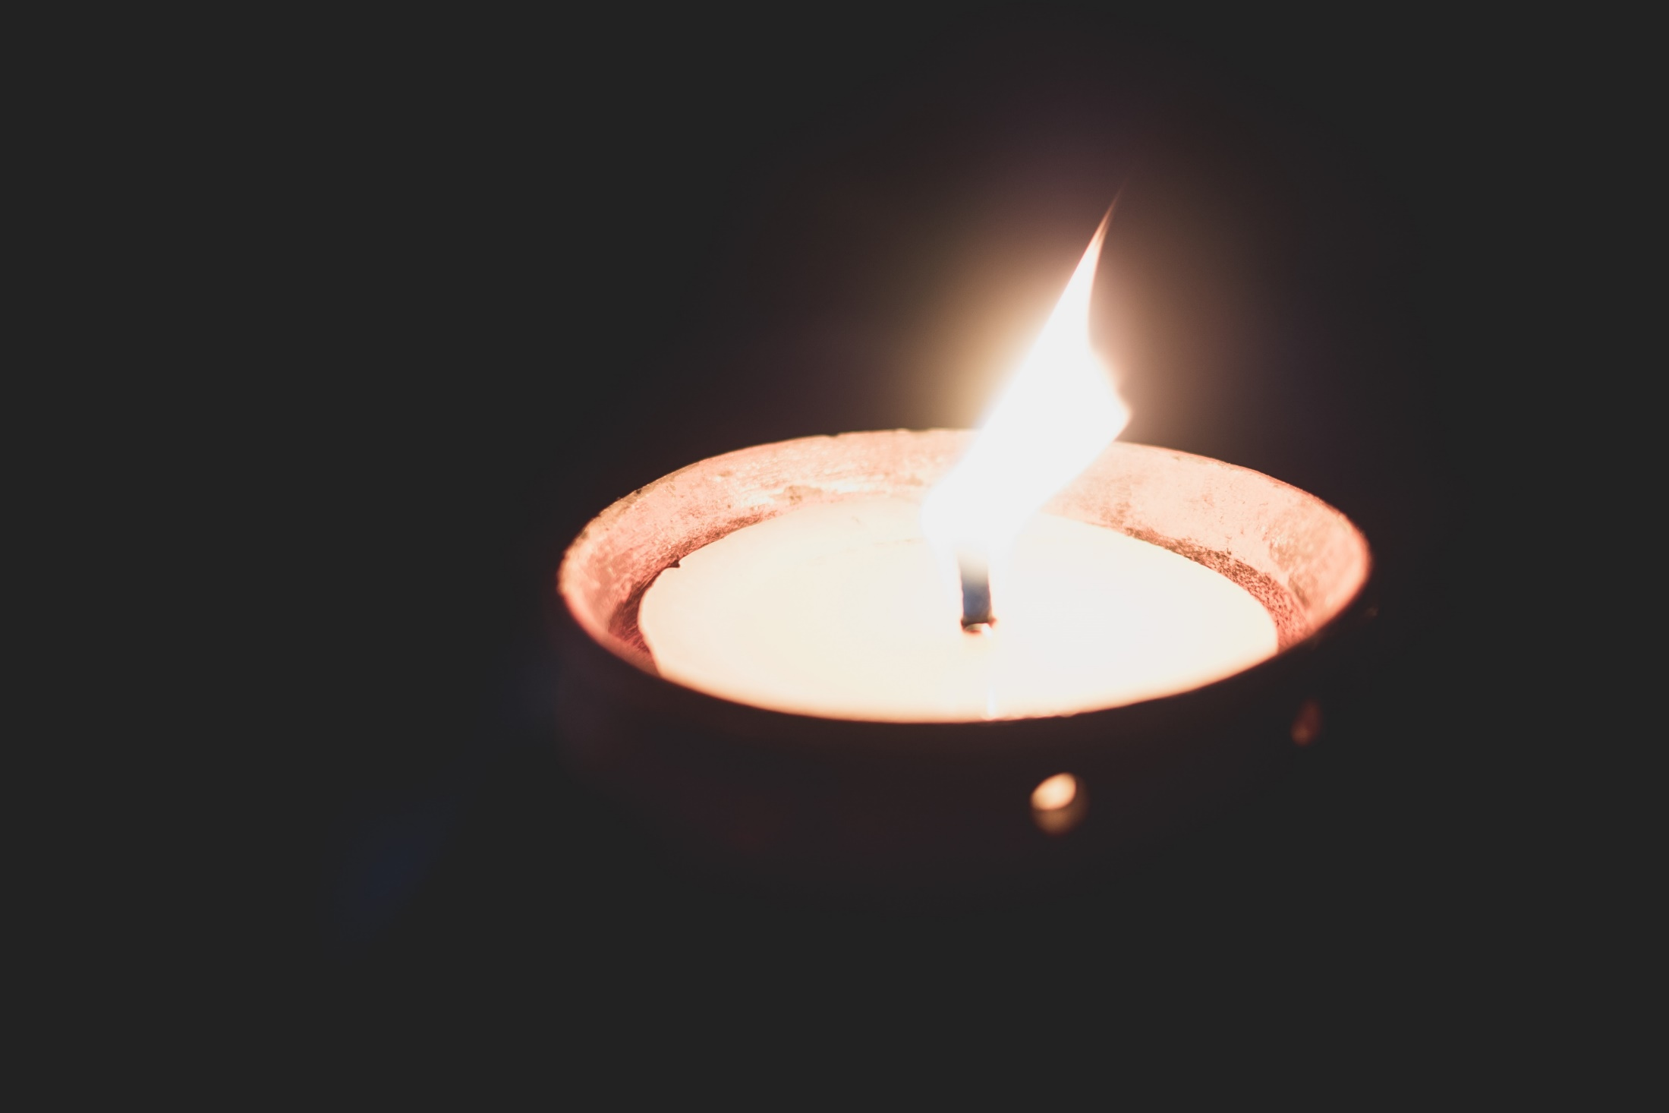
Lighting of memorial candles
Notes:
Script:
I invite you all to join me in lighting a candle. We light each candle in memory of all those who were murdered in the Holocaust, under Nazi persecution of other groups and in the more recent genocides in Cambodia, Rwanda, Bosnia and Darfur. We remember them.
Please join me in a minute of silence.

Slide 18
Closing remarks
Notes:
Thank you to everyone who joined us today. Particular thanks go to [names of individuals/organisations who contributed] for making this event so special.
This event is one of thousands that will mark HMD this year, taking place in schools, places of work, prisons, churches and many more settings. By attending, each of you has contributed to building a future which is free from genocide.
Despite the horrors of the Holocaust, we know that genocides have taken place since – indeed, the Holocaust prompted the coining of the legal term ‘genocide’ which has come to be used in Cambodia, Rwanda, Bosnia and Darfur. Closer to home on our streets, on public transport and online, people are still facing attacks because of who they are.
Holocaust Memorial Day presents an opportunity when people from all backgrounds come together to learn from the past and create a better future. It serves as a reminder that all of us not only have the ability to resist the forces of hatred – we have a responsibility to do so.
That includes everyone who has joined us today, and is why we are asking each of you to be the light in the darkness.
I will close this event by sharing the words of Holocaust survivor Gena Turgel MBE, Gena said: ‘We will continue to do our bit for as long as we can, secure in the knowledge that others will continue to light a candle long after us.’
Thank you.

