Slide 1


Slide 2




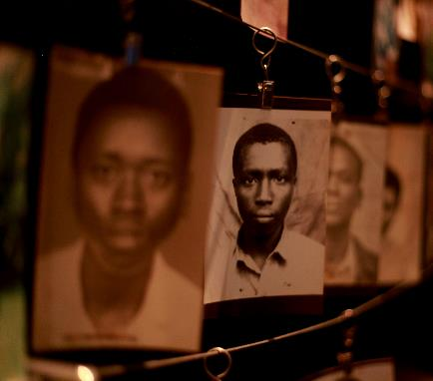
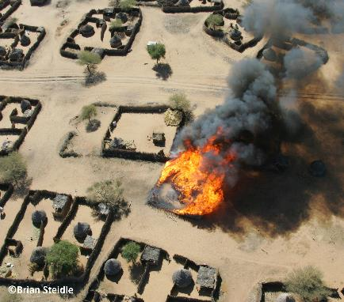

© Adam Jones
© Julian Buijzen
© Trocalre

Slide 3


© Adam Jones

Slide 4
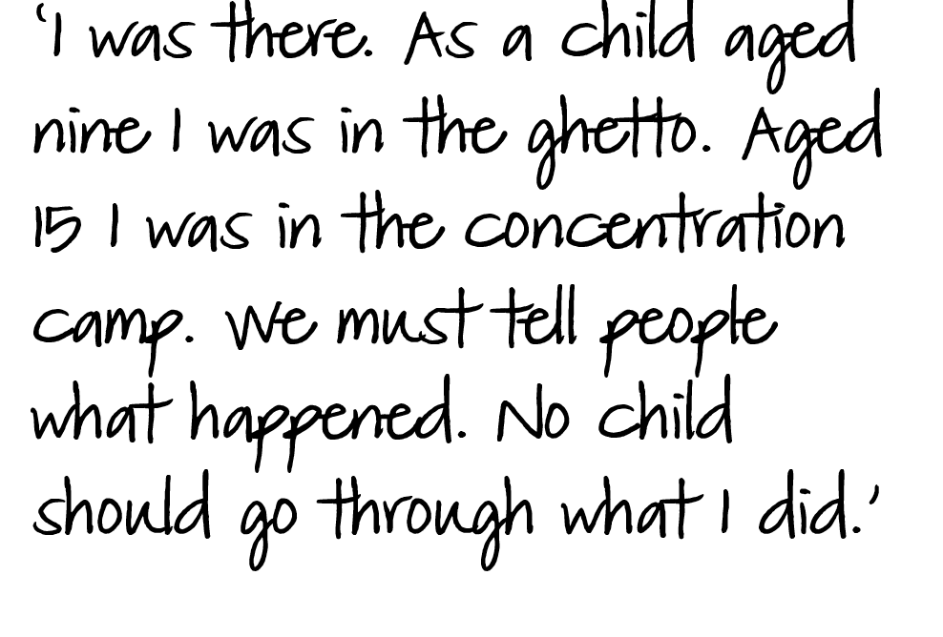



Slide 5


Slide 6
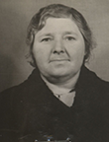

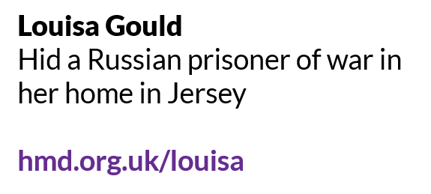

Slide 7

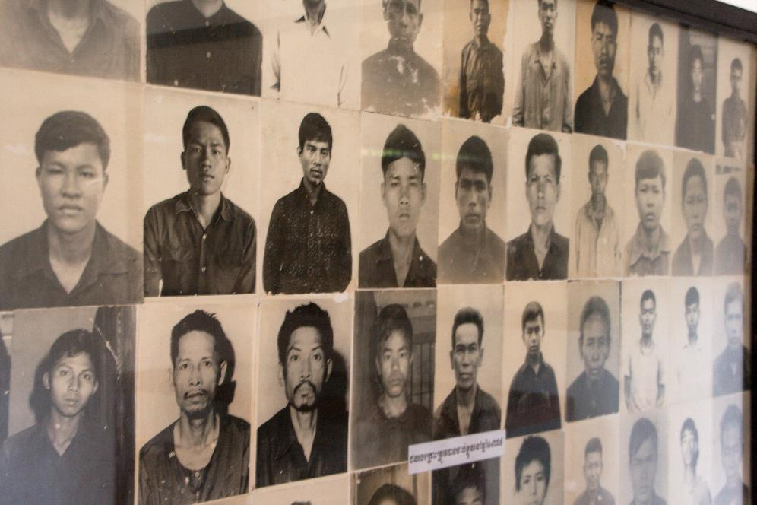
© Christian Haugen

Slide 8

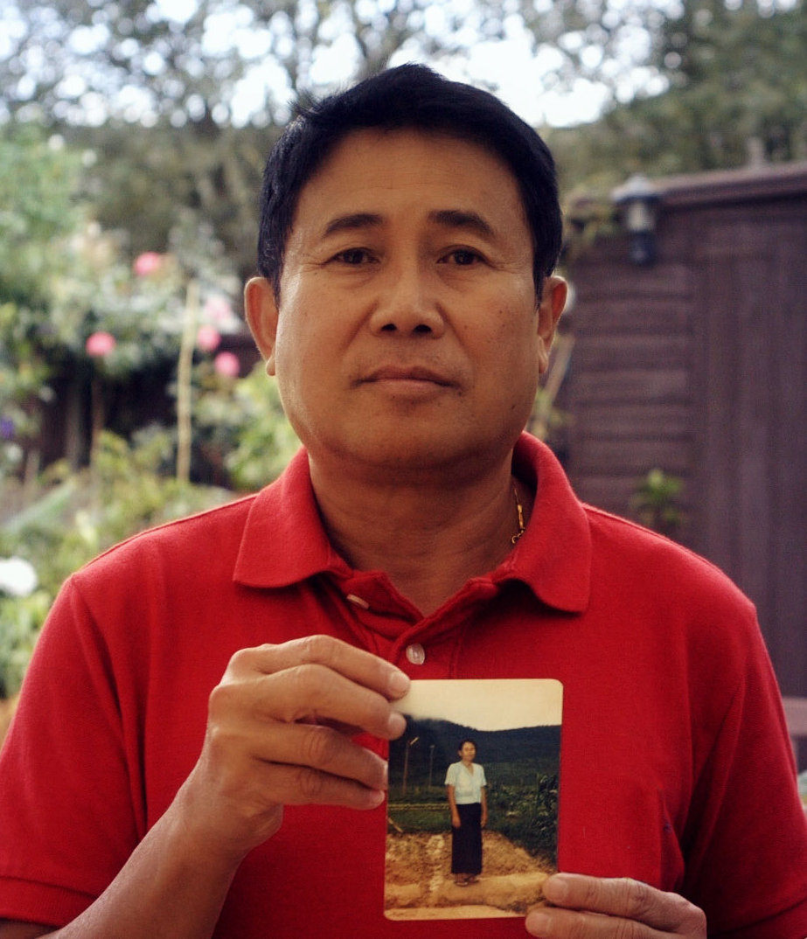


Slide 9

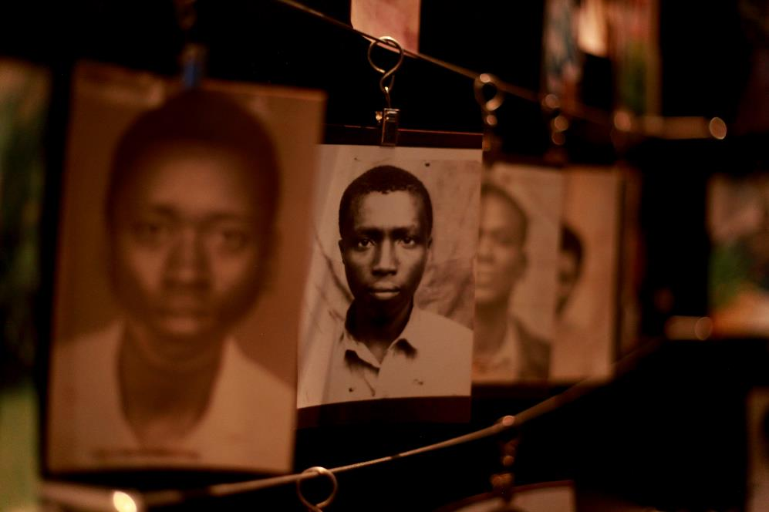
© Trocalre

Slide 10
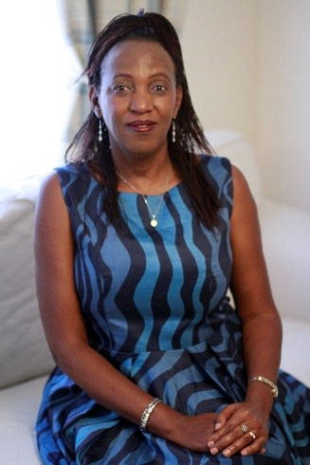



Slide 11


© Julian Buijzen

Slide 12
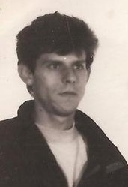



Slide 13

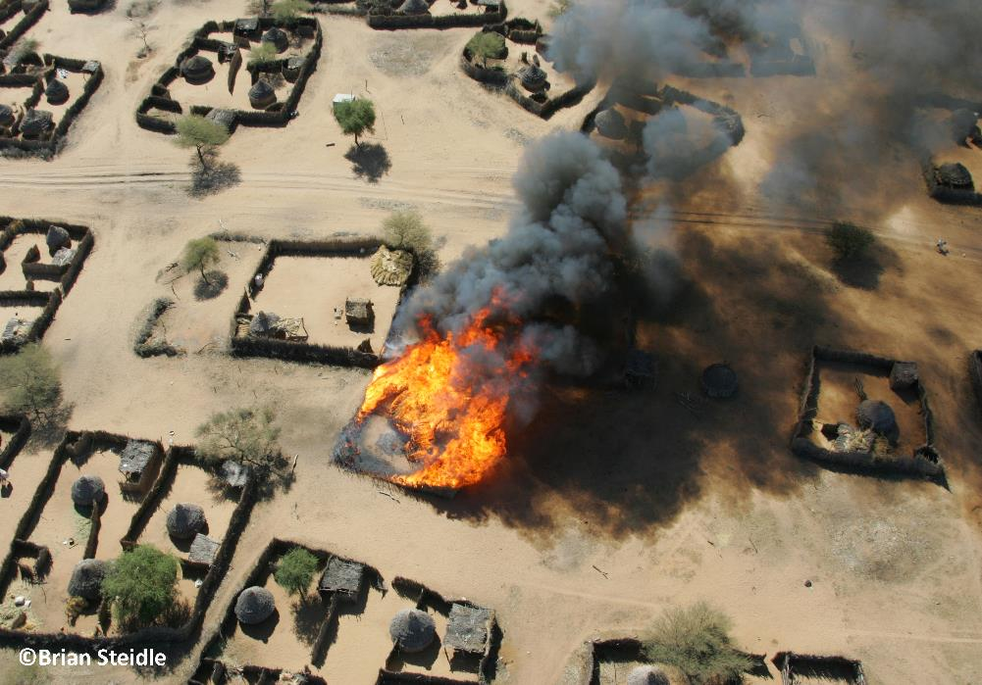

Slide 14




Slide 15







Slide 16




HMD activities take place across the UK.
Get involved in person or online.

Slide 17



