Slide 1
Darfur in Sudan
Holocaust Memorial Day
Holocaust Memorial Day is on
27 January every year

Slide 2
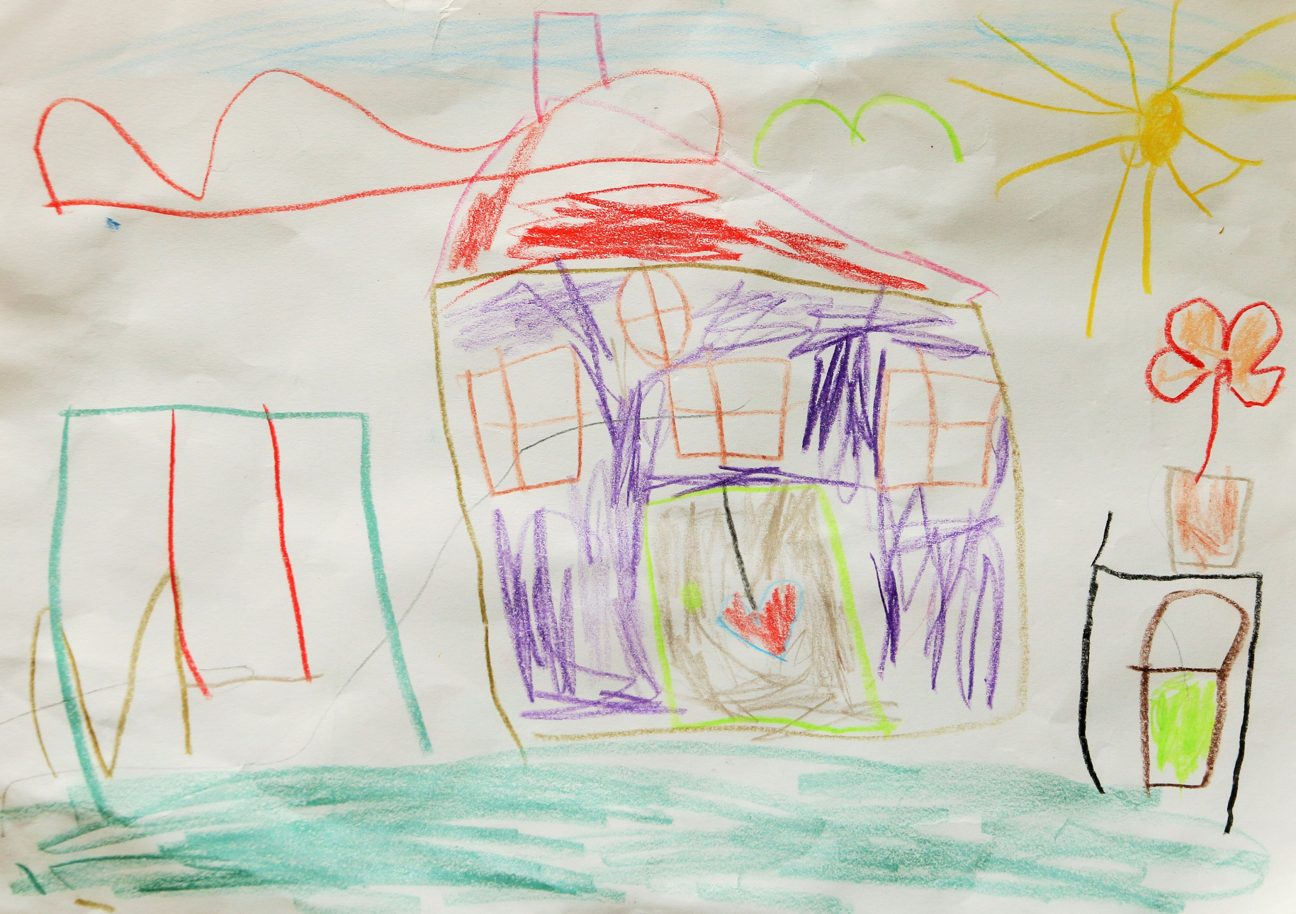
Darfur in Sudan
The ideal home
By Øyvind Holmstad

Slide 3
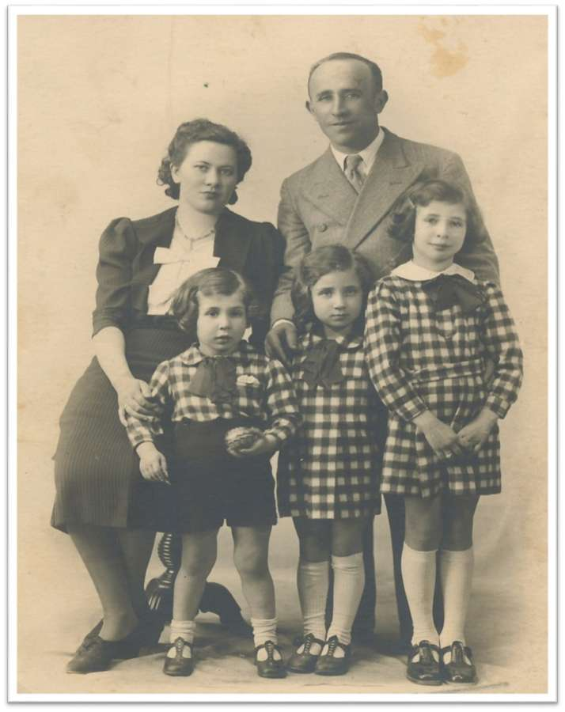
Darfur in Sudan
Renee Bornstein
Renee was born in France in 1934.
How many years ago was that?
She lived with her mother, father, older sister Helen, and
younger brother Joe.
Renee is the child in the middle in this photograph.
Renee and her family were Jewish.
That means that they follow the religion of Judaism.
https://www.holocaustmatters.org/

Slide 4
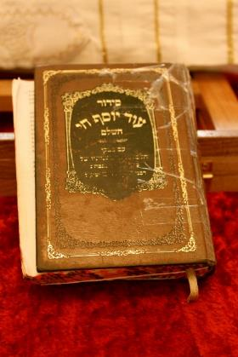
Darfur in Sudan
Being Jewish
Judaism is a very old religion and people who follow it are called Jews.
The holy book is called the Torah.
The Star of David –
a symbol of Judaism
Jewish people worship in buildings
called Synagogues.
Jewish spiritual leaders are called Rabbis.
What other religions do you know about?
By Urek Meniashvili (Own work) [CC BY-SA 3.0 (http://creativecommons.org/licenses/by-sa/3.0)], via Wikimedia Commons
By Velvet - Own work, CC BY-SA 3.0, https://commons.wikimedia.org/w/index.php?curid=4875188

Slide 5
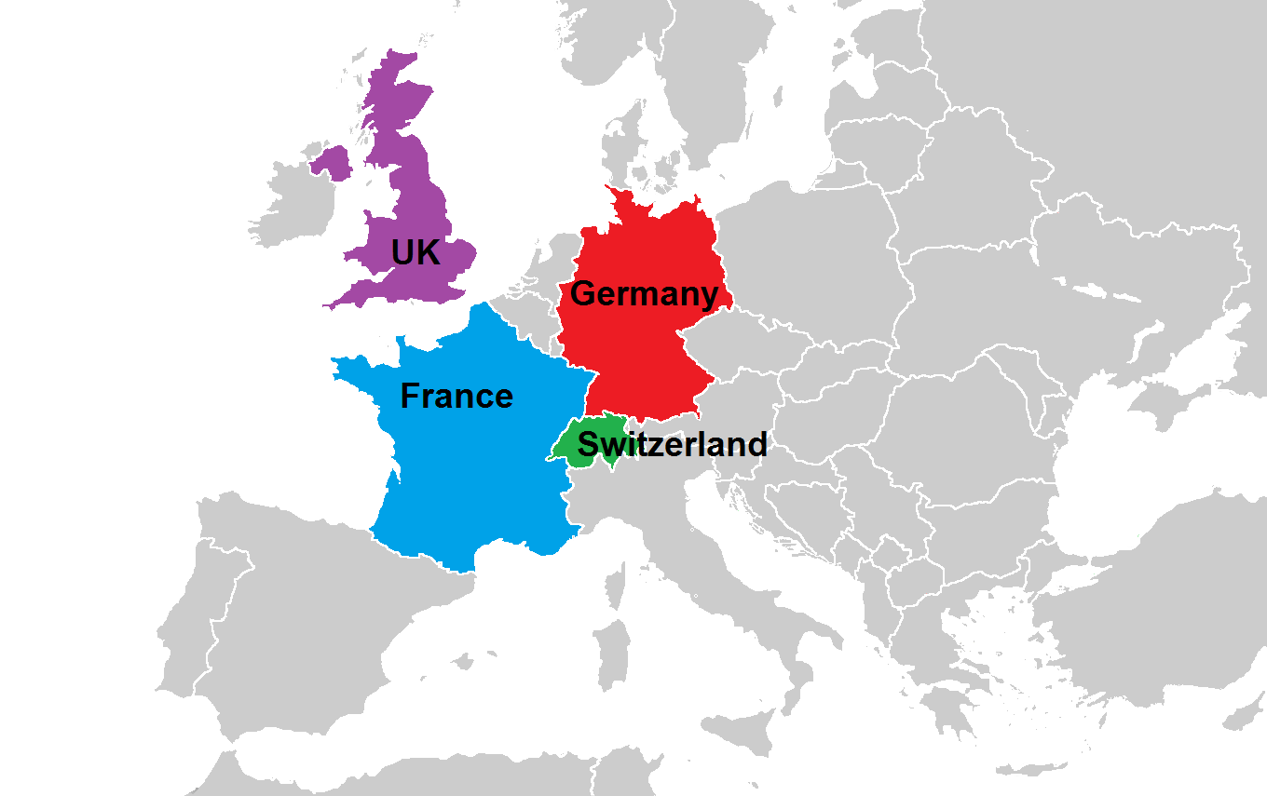
Darfur in Sudan
Countries in our story

Slide 6
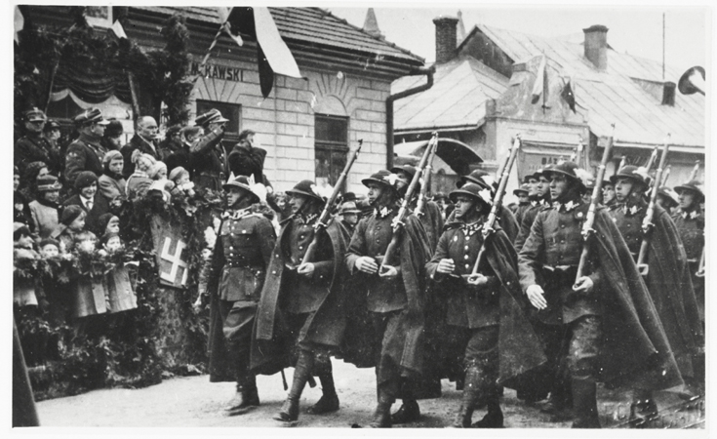
Darfur in Sudan
The Nazis
In the 1930s, a man called Adolf Hitler
was the leader of the Nazi Party in Germany.
The Nazis believed that people who were
Jewish were to blame for Germany’s problems,
and weren’t as good as other German people.
The Nazis wanted to take charge of all of Europe.
This led to a big war across Europe called
World War Two. It happened from 1939 to 1945.
Nazi soldiers

Slide 7
Darfur in Sudan
Renee Bornstein
Read
Write
Renee’s story
Answers to the
questions

Slide 8
Darfur in Sudan
Marianne Cohn
Marianne was a very brave woman, who
rescued lots of children.
She believed that what the Nazis were doing was wrong,
so she did something about it.

Slide 9
Darfur in Sudan
Write a postcard to Renee
You now have an opportunity to write a postcard to Renee, and she will send a message back for your class.
What have you learnt from her story?
How did her story make you feel?
Has she inspired you to do anything?

