Slide 1
Holocaust Memorial Day

Slide 2
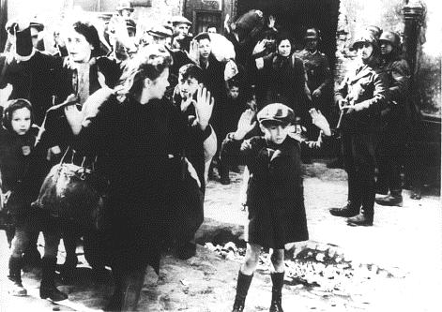
The Holocaust
Darfur in Sudan
This picture shows terrified
Jewish people in the Warsaw
Ghetto, and Nazi guards with guns.
The Holocaust was the attempt by the Nazis and their collaborators to murder all the Jews in Europe.
Six million Jewish men, women and children were killed in ghettos, mass-shootings, concentration camps and extermination camps.
Image © Wiener Library

Slide 3
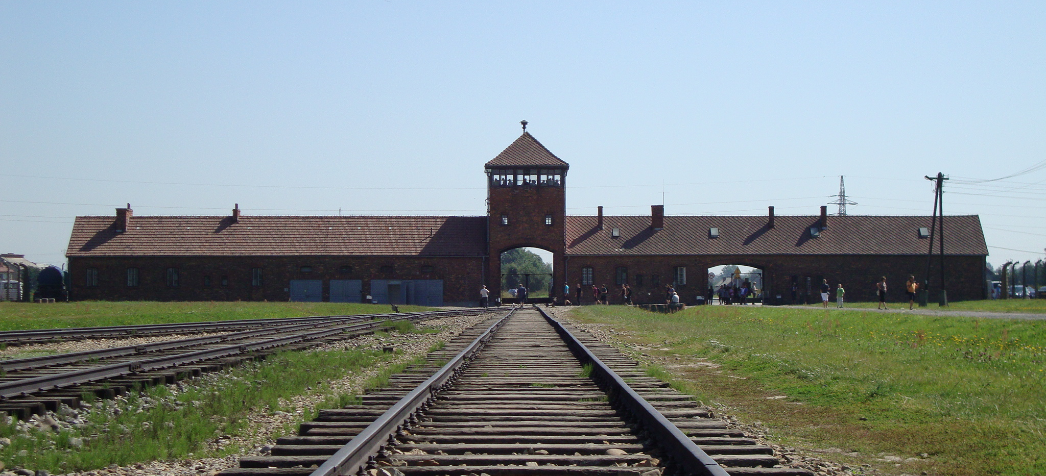
Why 27 January?
Darfur in Sudan
Auschwitz-Birkenau – Nazi death camp
27 January 1945 – Auschwitz-Birkenau was liberated.

Slide 4
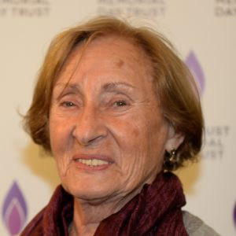
Susan Pollack
Darfur in Sudan
‘How do you get over such an experience?
Is it possible to walk away and learn to live with all of this?
How do you find the strength?
Life is precious – you can go in one of two ways – up or down.
I chose to walk away and rebuild my life.
There was no revenge, and no justice.’

Slide 5
Nazi Persecution
Darfur in Sudan
Different groups of people were given different
coloured badges in
concentration camps
The Nazis also persecuted and murdered people from a range of different groups, included Roma and Sinti people (‘gypsies’), gay people, black people, Jehovah’s Witnesses, political opponents.

Slide 6
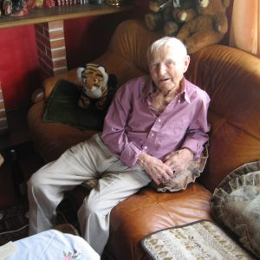
Rudolf Brazda
Darfur in Sudan
'If I finally speak, it's for people to know what we, homosexuals, had to endure in Hitler's days... it shouldn't happen again.'

Slide 7
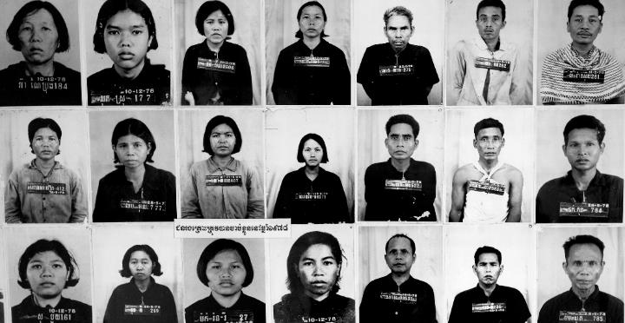
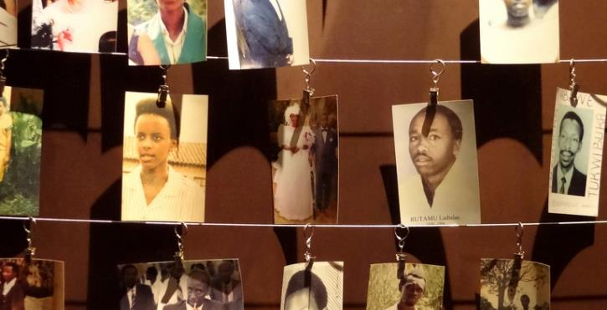
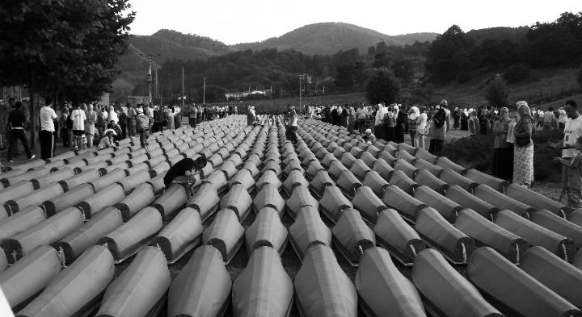
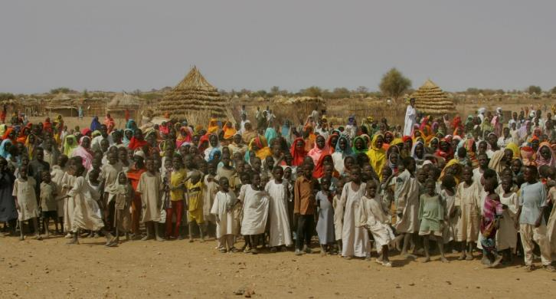
Genocides around the world
Darfur in Sudan
Cambodia, 1975 - 1979
Rwanda, 1994
Bosnia, 1995
Darfur, 2003 - present

Slide 8
Eric Eugene Murangwa
Darfur in Sudan

Slide 9
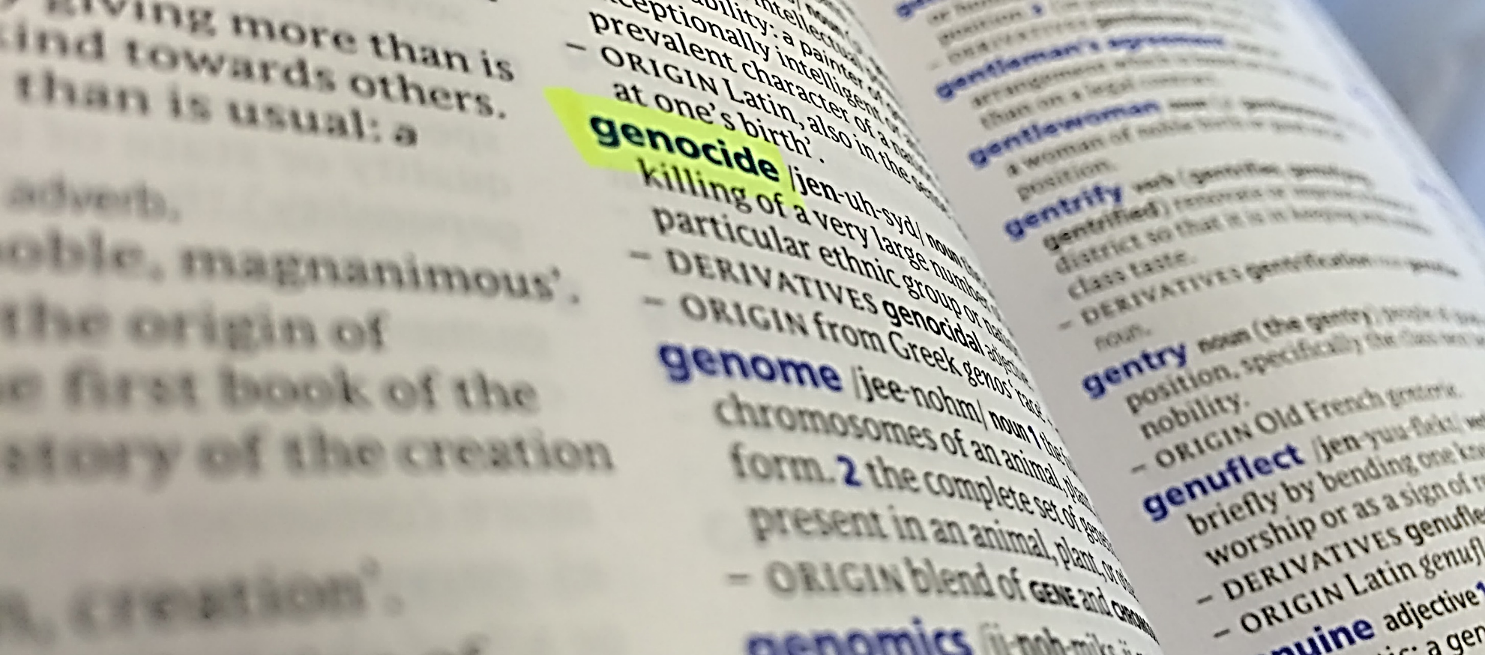
What is genocide?
Darfur in Sudan
Genocide is when a group of people is targeted for destruction just because of who they are, such as their race or their religion.
This has happened in many countries around the world.

Slide 10
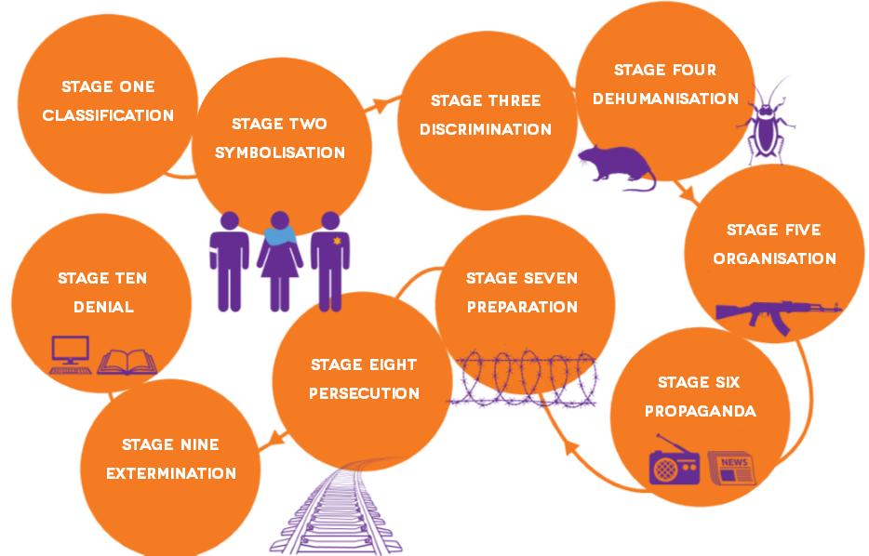
Darfur in Sudan
The ten stages of genocide

Slide 11
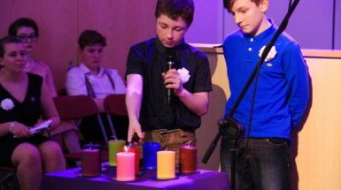
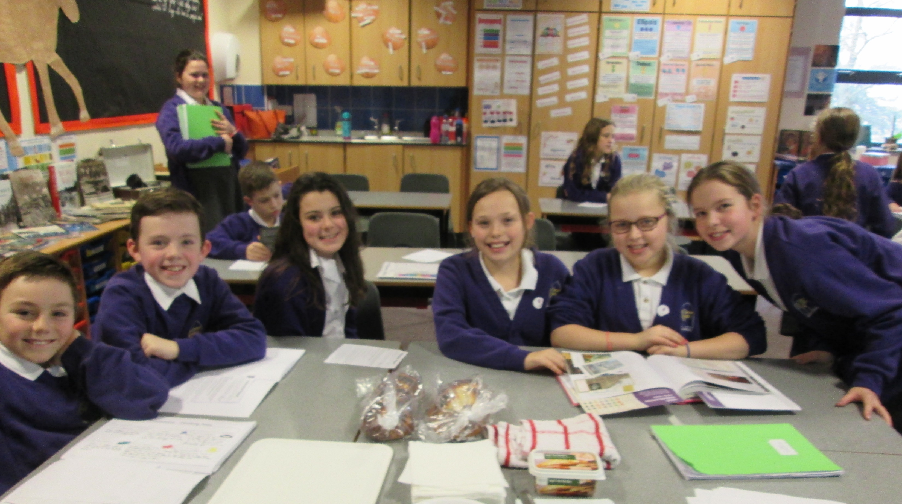
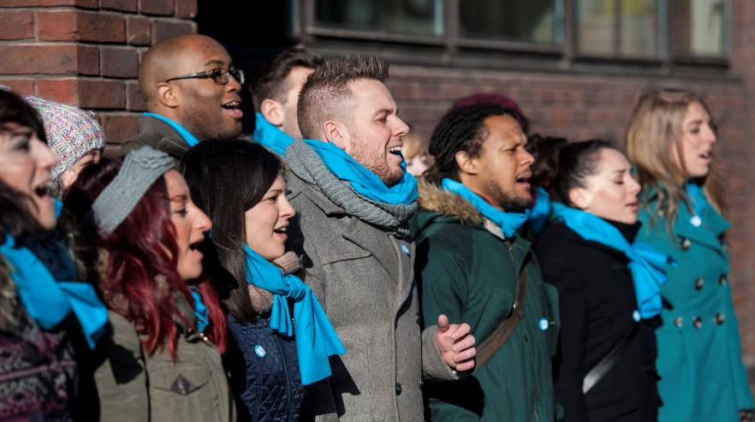
What happens on Holocaust Memorial Day?
Darfur in Sudan
Local HMD activities around the country

Slide 12
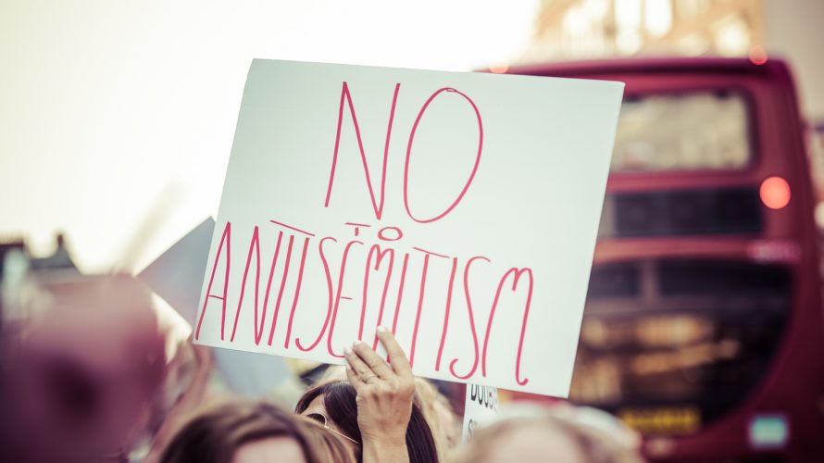
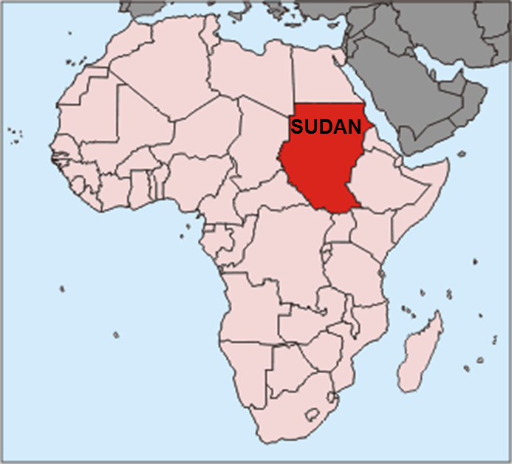
Why is this important to us?
Darfur in Sudan
Genocides today
There is currently a genocide happening
in Darfur – a region of Sudan.
Prejudice in the UK
CC BY-SA 3.0, https://commons.wikimedia.org/w/index.php?curid=60415

Slide 13
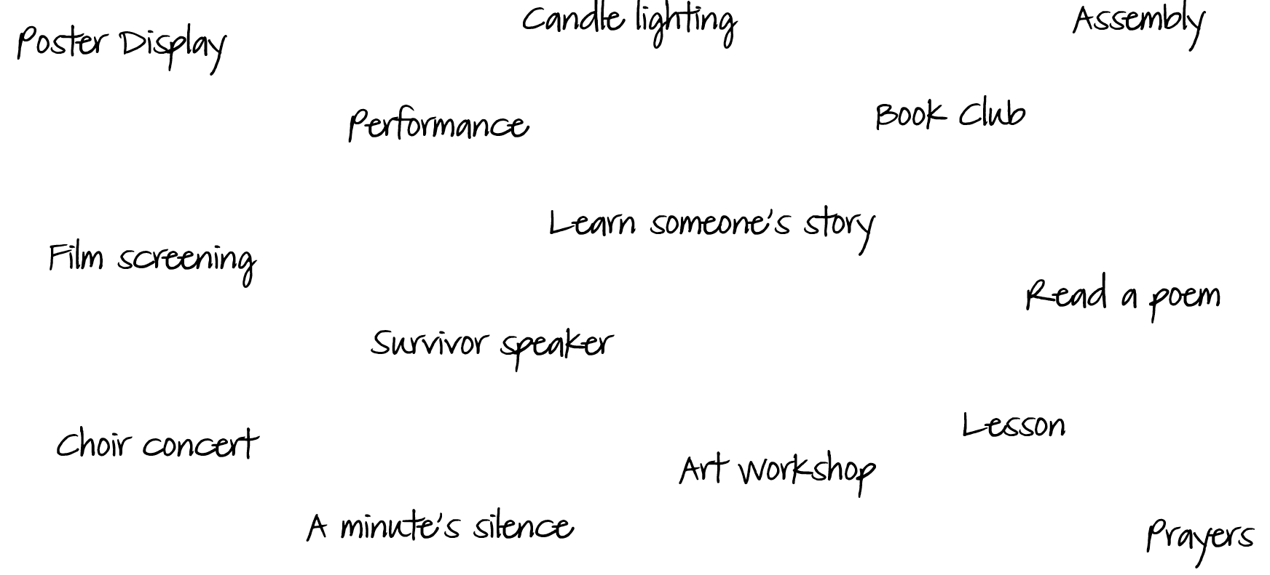
What can we do?
Darfur in Sudan

Slide 14
Auschwitz poem
Darfur in Sudan
The semiquaver chugging of the train on the track And the people on board who will never go back And the terror in the eyes of all the young ones to go With no one knowing as the train comes to slow
Those men at the station as the ramps drop down Where humanity lost is the only crippled sound Hope gone for those who stand behind the hard sharp wire And the smoke in the towers rises just a little higher
And the blue ink stabs a little harder in the skin Above the veins of despair where murder let it in And the terror in the eyes of all those about to leave Another train on the track no last minute reprieve
And the slow, crot...chet chugging of the train on the track; And the people on board. Who will ne...ver go.
Back.
Poem by Charles N. Whittaker
Read by actor Olivia Colman

Slide 15
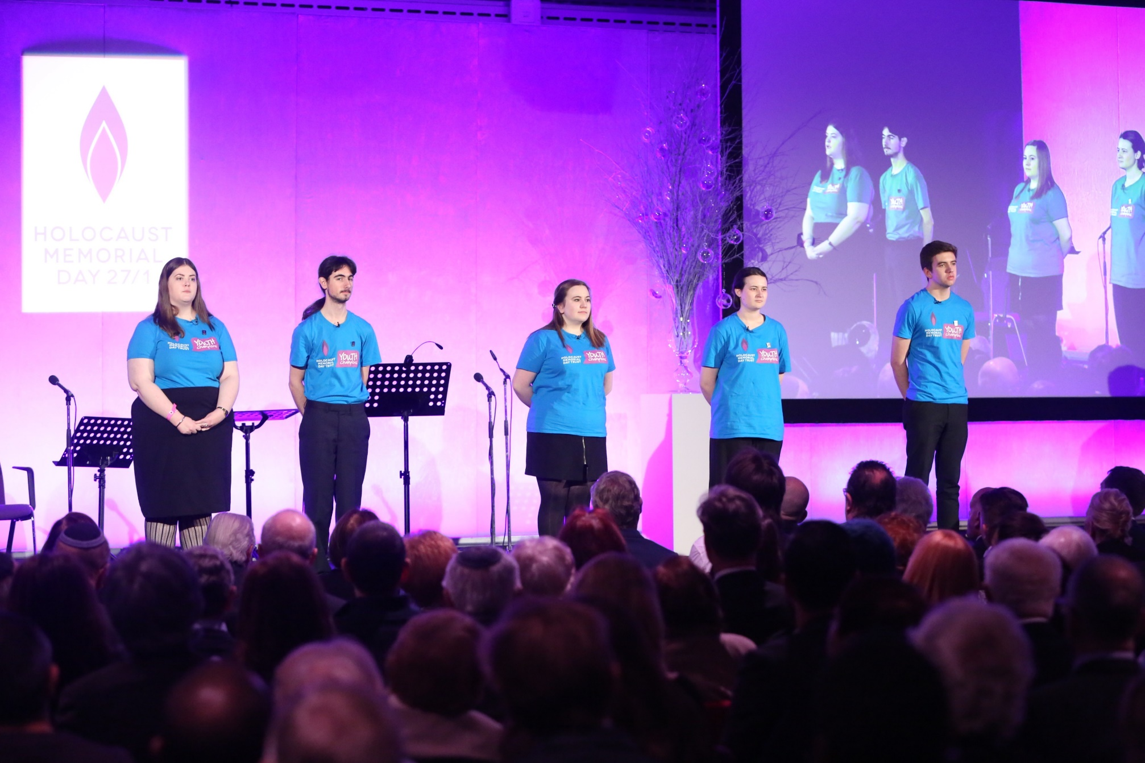
Youth programme
Darfur in Sudan
To find out more about
how young people can
get involved in
Holocaust Memorial
Day, visit:
hmd.org.uk/youth

Slide 16
Holocaust Memorial Day
Darfur in Sudan
Learn about what happened
How does it make you feel?
Take action

Slide 17
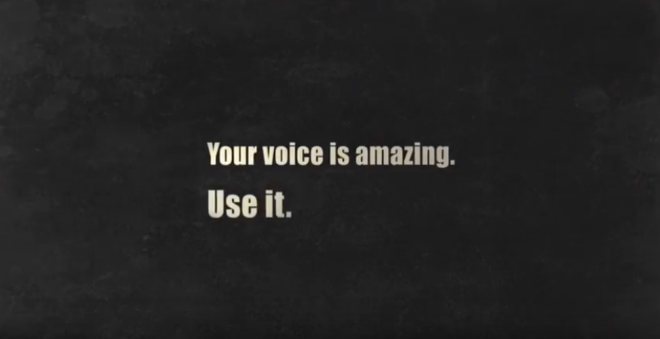
Your voice is amazing
Darfur in Sudan

Slide 18
Holocaust Memorial Day

